Slide 1
NAME
Student-ID
Course

Slide 2
INTRODUCTION
This Power BI dashboard is investigating the performance of Green Wheels Ltd. in terms of sales and environmental impact (Brandt & Brandt, 1998).
It addresses 4 of main performance indicators (KPIs) and other company details:
Sustainability
Sales revenue
Vehicle Total Cost of Ownership
Customer Segmentation

Slide 3
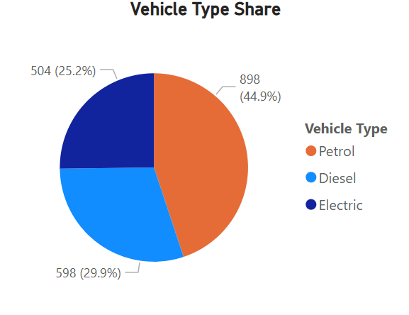
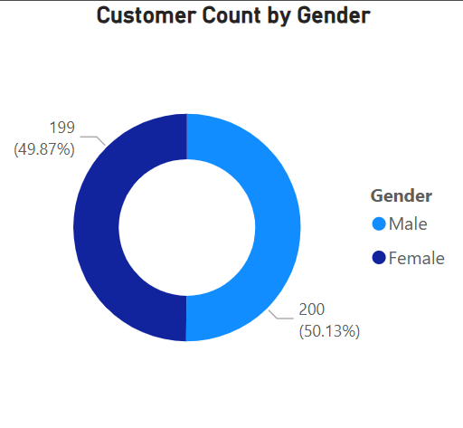
VEHICLE TYPE SHARE
A pie chart that shows by percentage how many vehicles of each type (Petrol, Diesel, or Electric) have been sold.
Highlights Adoption rate of Petrol Vehicle (EV) with respect to others.
Customer Count by Gender
A donut chart to show the distribution of customers according to their gender.
Assists in determining which campaigns to target towards the male or the female audiences

Slide 4
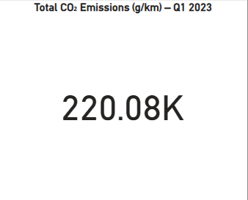
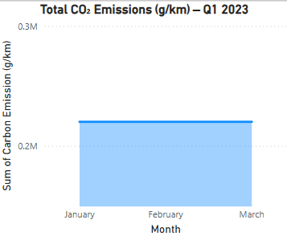
CO2 Emission (g/km)
Shows an estimated total CO 2 emissions by all the sold vehicles.
Gives a first hand measure of the effect to the environment.
It supports in sustainability reporting and compliance.

Slide 5
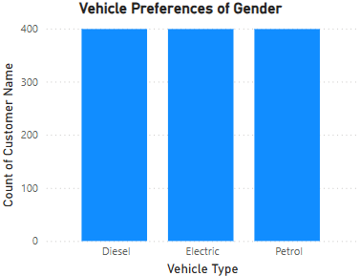
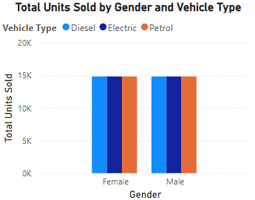
Customer Vehicle Preferences by Gender
Discloses gender segment of buying behavior.
Supports product placement and customization procedures.
Breaks down total units sold by gender and vehicle type.
Supports as a powerful KPI in identifying dominant customer.

Slide 6
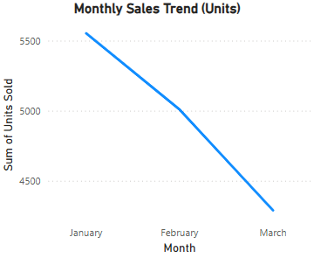
Sales Revenue
This KPI monitors the revenues earned as a result of selling vehicles (Q1 2023).
Assists in watching the financial wellbeing of the corporation.
Instructs sales strategy, budgeting and forecasting.

Slide 7
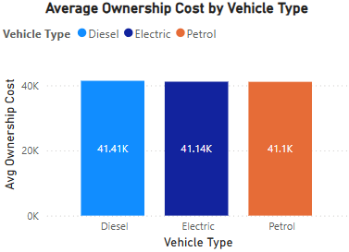
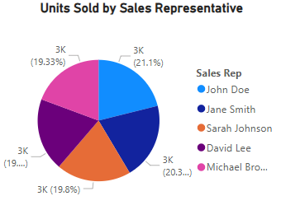
Units Sold and Total Cost of Ownership Overview
Vehicle Total Cost of Ownership
Calculated by combining the selling price and considered 5-year maintenance expenditure using DAX (Seamark, 2018).
Units Sold by Sales Representative
Shows the number of cars that each Sales Rep have sold overall.
Provides an obvious contrast of the rep performance of Q1 2023.

Slide 8
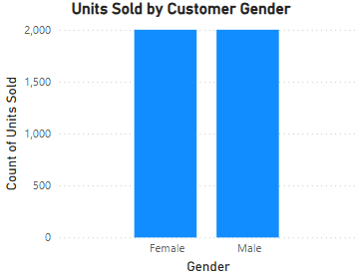
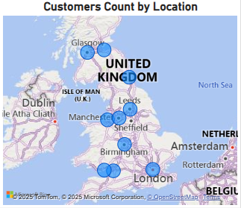
Customer Segmentation
Customer Segmentation is a powerful KPI to analyze behavior of customers.
It analyzes customers based on location and gender.
With the help of map chart we have analyzed customer count by location.
A stacked column chart shows units sold by gender.

Slide 9
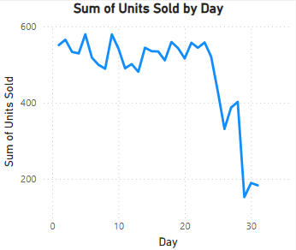
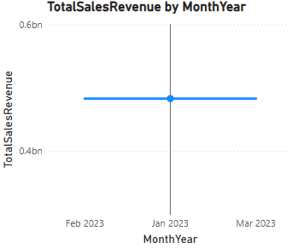
Daily Sales Volume and Monthly Revenue Trends
Units Sold By Day
This number of units sold on a daily basis with the busy and the slow days indicated.
Sales Revenue by Month Year
The line chart tracks total sales revenue per month, showing broader financial performance.

Slide 10
Conclusion
The dashboard shows how the company, Green Wheels Ltd., is performing in its sales and customer behavior and sustainable environment (Power BI, 2024).
The company can perform a data-driven decision using trends in sales, TCO, and segmentation.
It suggest results such as Petrol Vehicles are most widely used and January contains maximum sales. KPI produces decisions about different behaviors of customer segmentation.
PowerBi supports the company to do optional filters and prduce insights (Altdorf, 2024).

Slide 11
References
Brandt, S. and Brandt, S., 1998. Data analysis. Springer-Verlag.
Seamark, P., 2018. Beginning DAX with Power BI: The SQL Pro’s Guide to Better Business Intelligence. Apress.
Power, B.I., 2024. Power BI [online]
Altdorf, A., 2024. Operational Work Management with Data & Management Reporting: Utilizing Power BI Reporting and Visualization.

